Slide 1
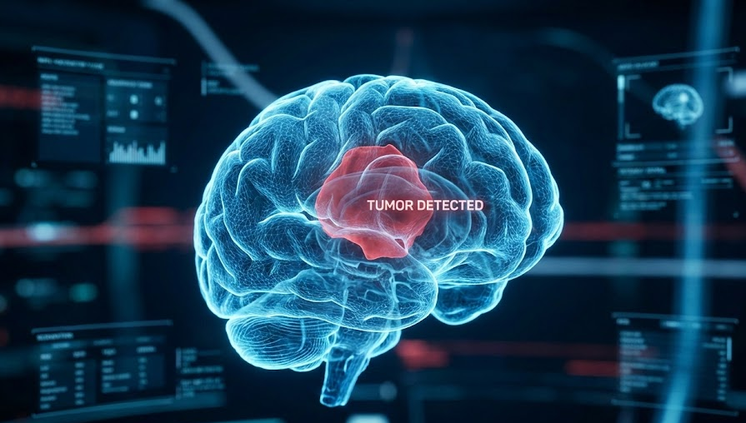
Brain Tumor Segmentation with U-Net++
114522125 陳彥璋
114522015 黃致穎
114527012 呂訢誠
Github repo
Brain Tumor Image DataSet : Semantic Segmentation
Notes:
Hello everyone, we are Group 11. Today, we will present our research on 'Brain Tumor Segmentation using U-Net++

Slide 2
Table of contents
01
02
Data check & preprocess
Introduction
03
Methodology: U-Net++
04
Training Strategy
05
06
Results
Conclusion
Notes:
Here is our table of contents today:
First, we will define the problem and our objectives. Then, explain how we cleaned and prepared the data. After that is our key Methodology – U-Net++ and some Training Strategy. At the end, we will share our Results and Conclusion.

Slide 3
01
Introduction
Problem Definition

Slide 4
Problem Definition
Goal: Semantic Segmentation of Brain Tumors from MRI Scans.
Input:
Images
coco_annonation
Output:
Area of tumor
Matrices:
Accuracy
Precision
Recall
F1-score
Focal
Dice
IOU
Notes:
Our main goal is Semantic Segmentation.
Input: We use MRI images and their correct labels (masks).
Output: The model predicts the exact area of the tumor.
Metrics: We focus on Dice and IoU, not just Accuracy.
IoU: This simply measures the Overlap. It checks: 'Does our prediction cover the same area as the real tumor?'
Dice: This is the standard score for medical AI. It is better than Accuracy because it really focuses on finding the tumor itself.
Focal: This helps the model focus on the small tumor parts instead of the large background."

Slide 5
02
Data check & preprocess
Cleaning & Augmentation

Slide 6
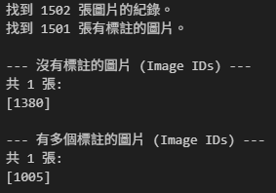
Data Check(Data Cleaning)
Data Format
Source: COCO JSON (Polygons)
Key Fields: segmentation, bbox
Dataset Overview
Split: Train(1502-2 images) / Validation(429 images) / Test(215 images)
Classes: Tumor(1) vs. Background(0)
Cleaning Action (Anomaly Removal)
Empty Annotations: Removed (Negative /Unlabeled samples)
Duplicate Annotations: Removed (Conflicting data)
Notes:
We utilized a dataset in COCO JSON format, specifically focusing on the segmentation and bbox fields for our task. Since this is a binary segmentation problem, we defined our classes simply as Tumor (assigned value 1) and Background (assigned value 0).
We initially found a total of 1,502 image records. During inspection, we removed 2 anomalous images:
One image had no annotations.
Another had conflicting annotations.
After cleaning, we split the dataset into:
429 images for Validation,
215 images for Testing,
and the remaining images for Training."

Slide 7
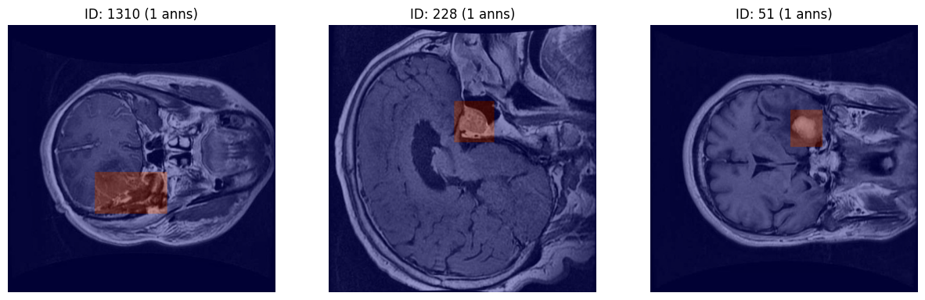
Data Check (Visual Inspection)
Random Sampling
Source: 3 random samples from Train Set.
Goal: Verify integrity of JSON annotations.
Notes:
After cleaning the dataset stats, we performed a visual inspection. We randomly sampled 3 images from the training set to ensure the annotation quality. As shown here, the generated masks (white areas) correctly align with the tumor regions in the MRI. This confirms that our raw data is valid before we apply any preprocessing.

Slide 8
Data Preprocess
Polygon to Mask
Convert coordinates to Binary Masks (0=Background, 1=Tumor)
Data Augmentation
Tool: Albumentations
Geometric: Resize (640*640), Flip, Rotation, Elastic Transform
Pixel-level: Gaussian Blur, Brightness & Contrast
Format Adaptation
Grayscale to RGB: Match ResNet34 input
Normalization: ImageNet Mean/Std
Notes:
Now let's talk about our preprocessing strategy. First, since our data is in polygon format, we convert these coordinates into binary masks. Second, to improve model robustness, we apply data augmentation using the Albumentations library. This includes resizing all images to 640 plus 640 pixels, random flipping, and rotation. Finally, we adapt the image format. Since we are using a ResNet34 encoder pre-trained on ImageNet, we convert our grayscale MRI scans into RGB format and apply standard normalization.

Slide 9
03
Methodology
U-Net++ & ResNet34

Slide 10
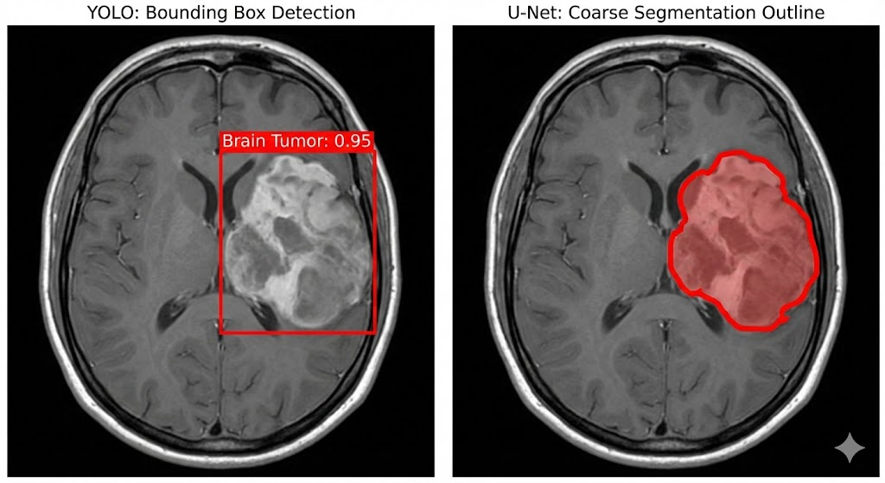
Quality improvement measures
How should we identify tumors?
Option A: Object Detection (e.g., YOLO)
Output: Bounding Box (Rectangle).
Focus: "Where is the object?"
Option B: Semantic Segmentation (e.g., U-Net)
Output: Pixel-wise Mask (Exact Shape).
Focus: "Which pixels belong to the object?

Slide 11
Segmentation is Critical for Medical Imaging
Limitations of Bounding Boxes (YOLO):
Noise: Includes healthy brain tissue within the box.
Imprecision: Cannot measure tumor volume/area accurately.
Advantages of Segmentation (U-Net):
Precision: Delineates exact tumor boundaries.
Clinical Value: Essential for radiation therapy planning (sparing healthy organs).
Verdict: Semantic Segmentation is the superior choice.

Slide 12
System Architecture Overview
Implementation Framework: segmentation_models_pytorch (SMP)
The Pipeline:
Input: MRI Images.
Encoder: ResNet34 (Pre-trained).
Decoder: U-Net++ (Nested Skip Pathways).
Output: Binary Tumor Mask.
Key Design Choice:
Combining robust feature extraction (ResNet) with fine-grained localization (U-Net++).

Slide 13
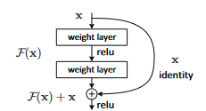
Encoder: ResNet34
Why ResNet34?
Deep but Trainable: 34 layers deep, enabled by Residual Learning.
The "Vanishing Gradient" Solution:
Shortcut Connections: y = F(x) + x
Allows gradients to flow through the network easily.
Role:
Extracts hierarchical features from textures to semantic shapes

Slide 14
Transfer Learning Strategy
Initialization:
Encoder weights pre-trained on ImageNet.
Advantages:
Universal Features: Edges, curves, and blobs are learned explicitly.
Faster Convergence: Skips the initial "random guessing" phase.
Data Efficiency: Critical for medical datasets with limited samples.

Slide 15
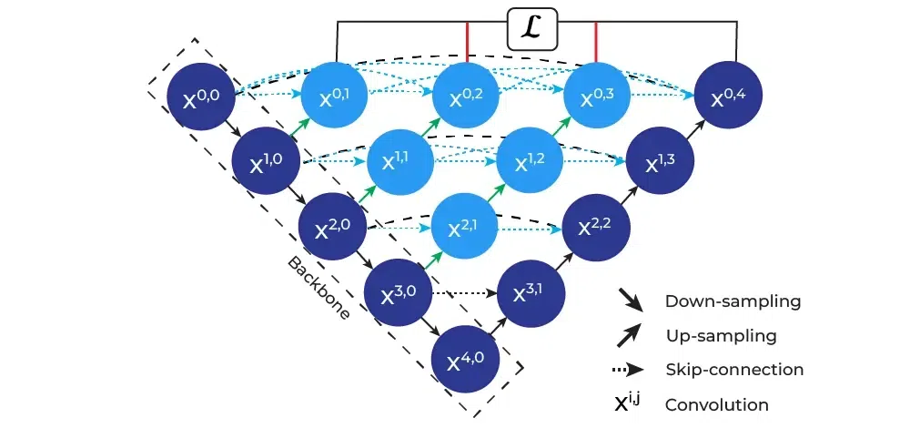
Decoder: U-Net++
Architecture Overview:
A Nested U-Net structure.
Replaces empty space with Dense Convolution Blocks.
Core Mechanism:
Nested Skip Pathways: Features are gradually transformed before fusion.
Deep Supervision: Allows the model to learn at multiple scales simultaneously.
Result: Effectively bridges the semantic gap.

Slide 16

Inside the Dense Skip Pathways
How it works:
Every node receives input from all previous nodes at the same level.
Formula:
Multi-Scale Feature Fusion:
Captures features at varying scales within the skip pathways.
Functions like an ensemble of U-Nets of different depths.
Impact:
Significantly improves segmentation accuracy for both small and large tumors.

Slide 17
04
Training Strategy
Hybrid Loss & Optimization

Slide 18


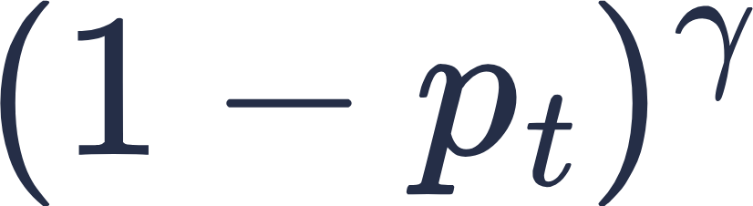
Challenge 1: The "98% Background" Trap
Standard Cross Entropy
treats all pixels equally. Predicting 'Background Only' yields 98% Accuracy."
Our Solution: Focal Loss
α = 0.8 : Increases weight for Tumor pixels (Positive samples).
= Confidence
: Reduces loss for easy samples (Background), focusing the model on hard examples.
Verdict: Secures Pixel Precision.

Slide 19
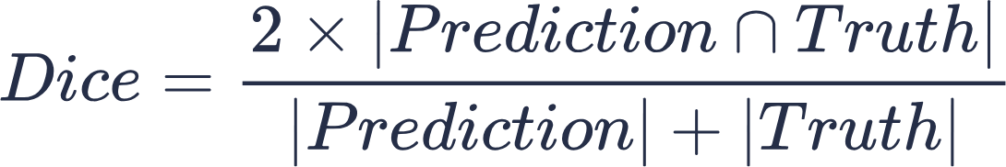
Challenge 2: The Fragmentation Problem
Lack of Spatial Context
Ignores spatial structure, resulting in fragmented masks.
Our Solution: Dice Loss
Numerator (2⋂): Directly maximizes the overlap area.
Denominator: Normalizes by the total size.
Verdict: Secures Structural Integrity.

Slide 20

Hybrid Strategy: The Best of Both Worlds
Result:
Complementary Optimization: Pixel precision (Focal) + Region overlap (Dice).
Focal Loss forces the model to focus on hard-to-classify pixels at tumor boundaries.
Dice Loss prevents the background class from dominating the gradient, ensuring small tumors are detected.

Slide 21
Optimization Setup & Hyperparameters
Optimizer: Adam
Initial Learning Rate: 1 X 10⁻⁴
Robust handling of sparse gradients.
Scheduler: ReduceLROnPlateau
Monitor: Validation Dice Score (Mode: Max).
Patience: 5 Epochs (Reduces LR when Dice stops improving).
Training Specs:
Batch Size: 16
Max Epochs: 100

Slide 22
Efficiency & Stability Strategy
Automatic Mixed Precision (AMP):
Tech: float16 computation + GradScaler.
Benefit: 50% less memory usage → Allows larger Batch Size & faster training.
Early Stopping:
Constraint: Patience = 15 Epochs.
Mechanism: Terminates training if no improvement in Validation Dice.
Benefit: prevents Overfitting and saves GPU hours.

Slide 23
Dynamic Thresholding
Due to class imbalance, the optimal decision boundary is often not at 0.5.
Our Algorithm:
Scan: Test thresholds from 0.30 to 0.75 on the Validation Set.
Select: Find the exact threshold (T_{opt}) that maximizes the Dice Score.
Apply: Use T_{opt} for final Test Set predictions.

Slide 24
05
Experimental Results

Slide 25
Results
Training epoch : 53 (early stop triggered)
Saved best model :
Epoch : 38
Train Loss : 0.0610
Valid Loss : 0.1125
Best threshold on Validation set : 0.5
Valid Dice : 0.8147

Slide 26
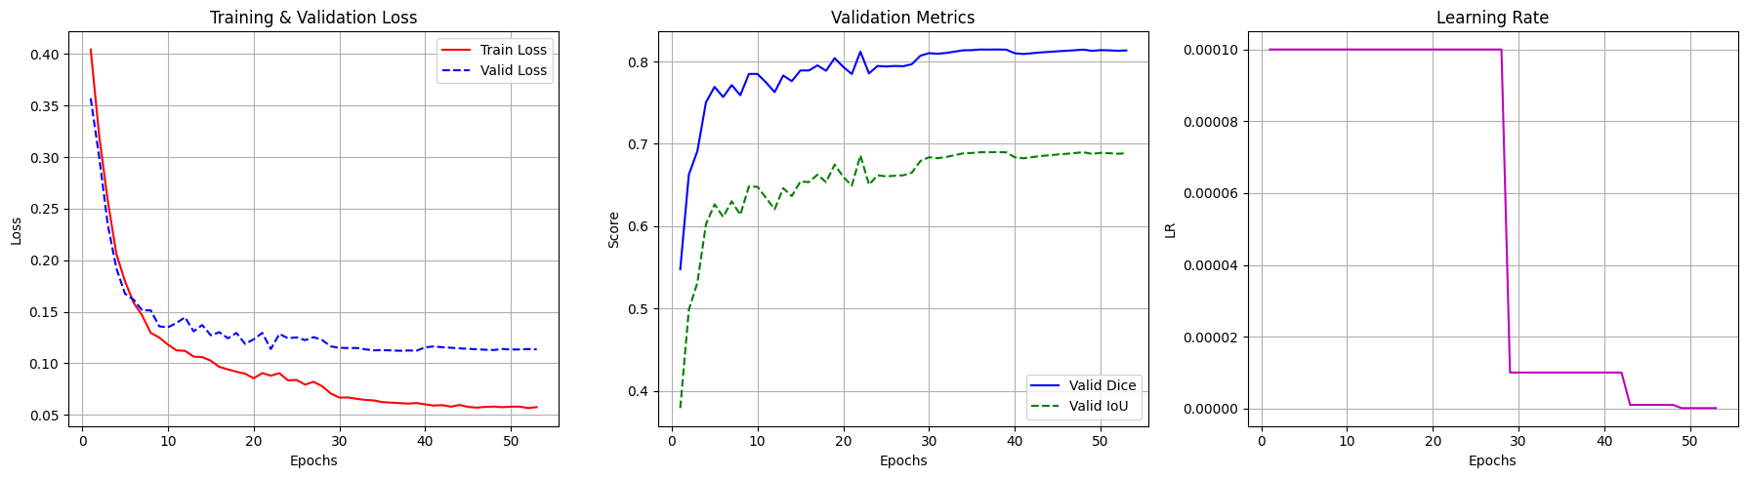
Results
Training Graph :

Slide 27
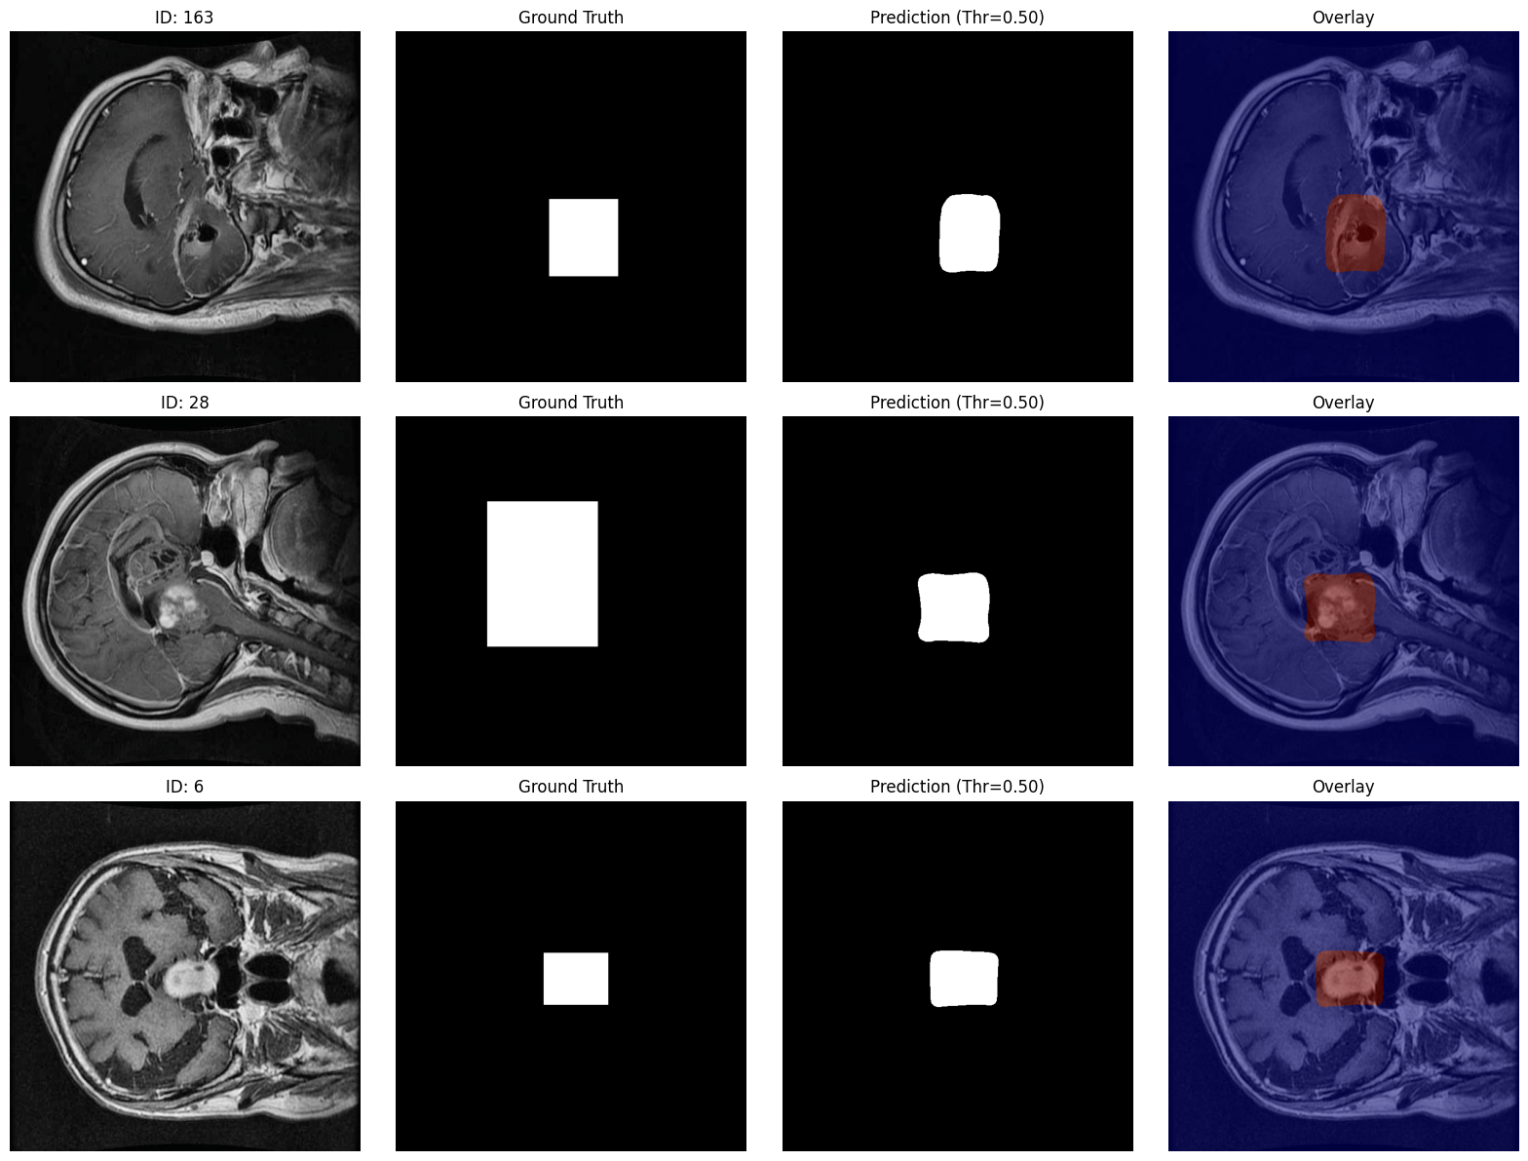
Results
Test Result (Threshold = 0.5) :
Mean Dice Score : 0.8106
Mean IoU Score : 0.7141
Mean Precision : 0.8268
Mean Recall : 0.8447
Mean F1 Score : 0.8106
Mean Accuracy : 0.9870

Slide 28
06
Conclusion

Slide 29
Conclusion
Robust Pipeline: Established a complete Brain Tumor Segmentation pipeline using U-Net++ (ResNet34) with data cleaning (removed anomalous samples).
Performance: Achieved a Dice Score of 0.8106 on the test set.
Optimization: Implemented Threshold Tuning on the validation set to maximize segmentation accuracy
Efficiency: Leveraged Mixed Precision (AMP) and Early Stopping to ensure efficient and stable training.
Future Work: Plan to explore advanced data augmentation and ensemble methods to further boost generalization.

Slide 30
Thanks

